Slide 1
Agile, Waterfall, and Scrum Methodologies
A Comparative Overview for Software Development

Slide 2
Introduction
Purpose: Understand the core concepts of Agile, Waterfall, and Scrum.
Why it matters: These methodologies guide project management, software development, and team collaboration

Slide 3
What is Waterfall?
Definition: Waterfall is a traditional, linear project management methodology.
Key Characteristics:
Sequential, step-by-step process.
Each phase must be completed before moving to the next.
Fixed scope and requirements.
Ideal for: Well-defined projects with little to no changes after requirements are set.

Slide 4
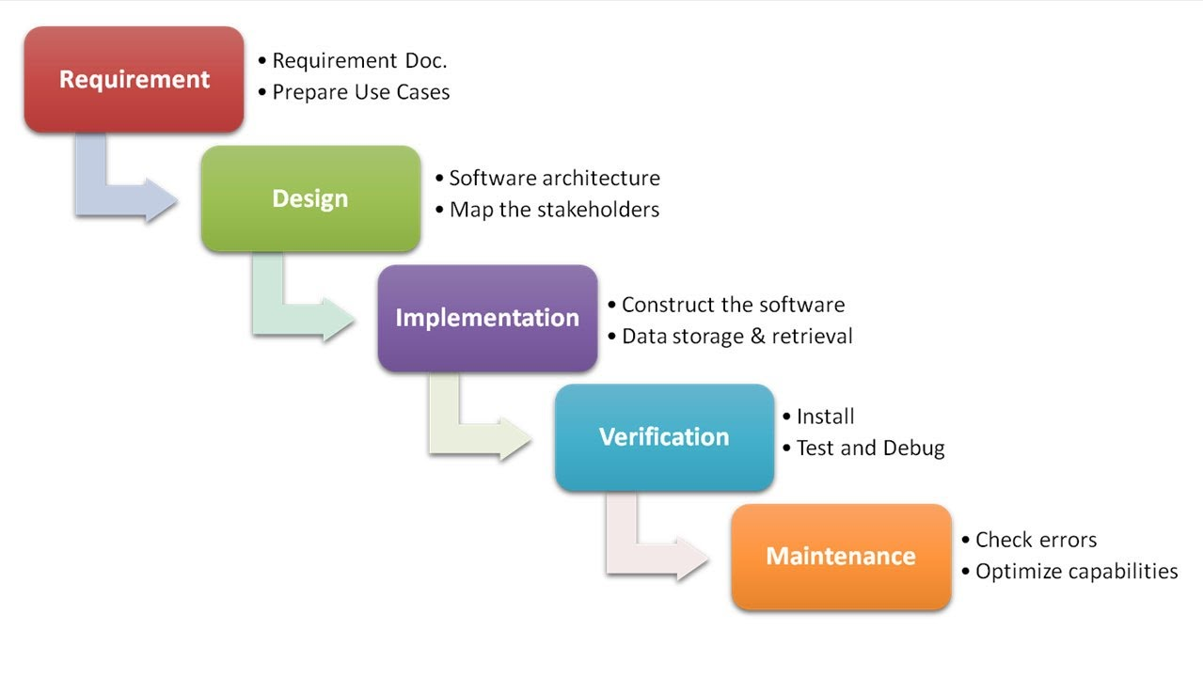
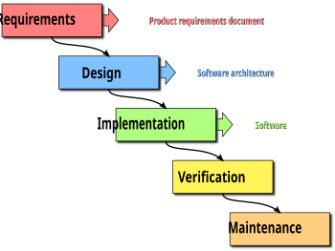
WATERFALL MODEL
ThePhoto by PhotoAuthor is licensed under CCYYSA.

Slide 5
Waterfall Phases
Requirements Gathering: Define all project requirements upfront.
System Design: Plan the architecture and design.
Implementation: Code and develop the solution.
Verification (Testing): Test the system for bugs and ensure it meets requirements.
Deployment: Deploy the system for use.
Maintenance: Fix issues and make improvements post-launch

Slide 6
Pros and Cons of Waterfall
Pros:
Clear structure with defined stages.
Easier to manage due to predictable timelines.
Well-suited for small, fixed-scope projects.
Cons:
Inflexible to changes once the project is underway.
Delayed testing until later in the process.
Can lead to scope creep if not tightly controlled.

Slide 7
What is Agile?
Definition: Agile is an iterative, flexible approach to project management and software development.
Key Characteristics:
Focuses on continuous improvement and rapid delivery.
Emphasizes collaboration with stakeholders.
Work is divided into small, manageable cycles (sprints).
Ideal for: Projects that require frequent changes and evolving requirements.

Slide 8
Agile Principles
Iterative development: Work is done in short sprints (usually 1-4 weeks).
Customer collaboration: Regular feedback to ensure alignment with customer needs.
Responding to change: Embraces changes in requirements, even late in development.
Simplicity: Focus on delivering the most valuable features quickl

Slide 9
Agile Process Overview
Stages:
Sprint Planning: Define the work to be done in the sprint.
Daily Standups: Short meetings for team members to share progress and challenges.
Sprint Review: Showcase completed work to stakeholders at the end of the sprint.
Sprint Retrospective: Reflect on what went well, what didn’t, and how to improve.

Slide 10
What is Scrum?
Definition: Scrum is an Agile framework used to manage and complete complex projects.
Key Characteristics:
Structured roles, events, and artifacts.
Focuses on teamwork, accountability, and delivering value in iterations.
Ideal for: Teams working on complex projects that require continuous feedback and incremental development.

Slide 11
Scrum Framework
Roles:
Product Owner: Manages the product backlog, prioritizes work.
Scrum Master: Ensures Scrum practices are followed and removes obstacles.
Development Team: Responsible for delivering the product increment.
Artifacts:
Product Backlog: A prioritized list of features and tasks.
Sprint Backlog: The work selected for the current sprint.
Increment: The working product delivered at the end of the sprint.

Slide 12
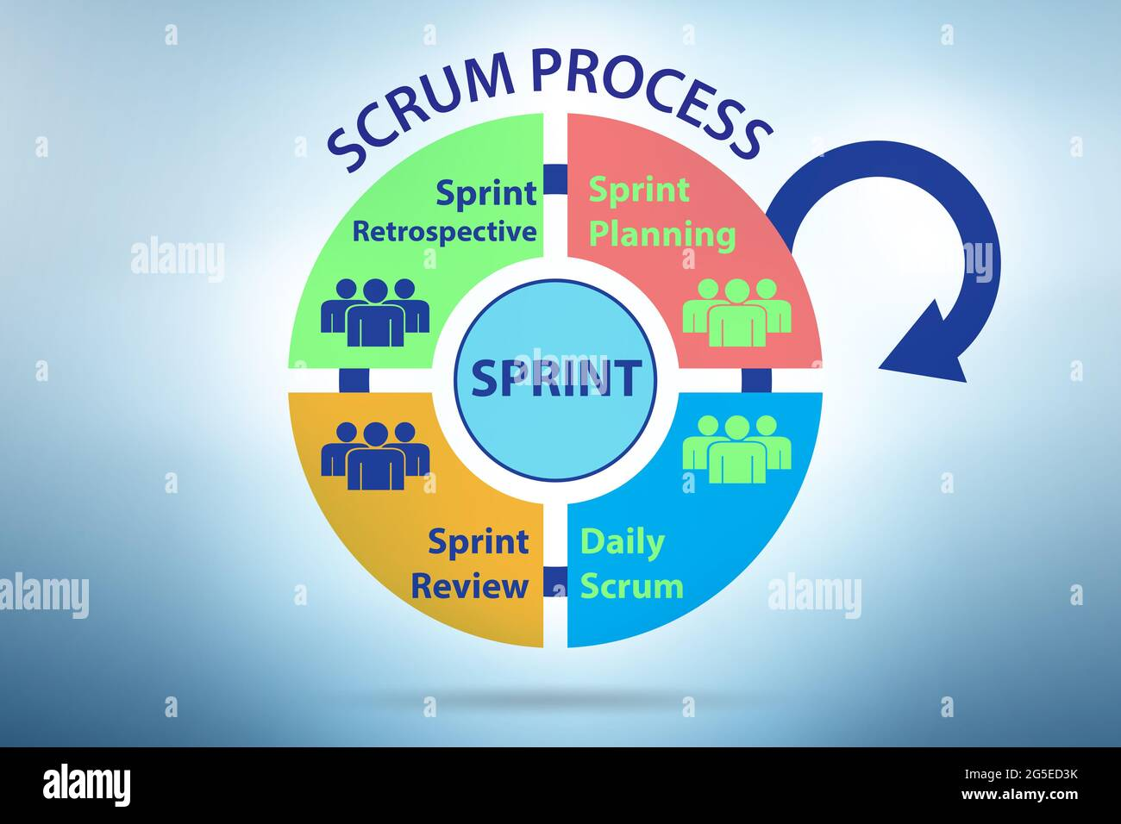
Scrum Events

Slide 13
Scrum Events
Key Scrum Events:
Sprint: A time-boxed iteration where work is completed (usually 1-4 weeks).
Sprint Planning: Planning the work for the sprint.
Daily Scrum (Standup): Daily meetings to track progress.
Sprint Review: Review of completed work with stakeholders.
Sprint Retrospective: Reflecting on the process for continuous improvement.

Slide 14
Comparison: Waterfall vs Agile vs Scrum
Aspect | Waterfall | Agile | Scrum
Approach | Linear, sequential | Iterative, flexible | Agile, with structure
Scope | Fixed, predefined | Evolving, flexible | Evolving, flexible
Phases | Defined, one after the other | Short cycles (sprints) | Cycles of sprints, with roles
Customer Feedback | After project completion | Continuous feedback | After each sprint
Best For | Well-defined, simple projects | Dynamic, changing projects | Complex projects with a need for teamwork and feedback

Slide 15
Thankyou

